Slide 1
Smart Spreading Factor Assignment for LoRaWANs
Tugrul Yatagan
yatagan@itu.edu.tr
Sema Oktug
oktug@itu.edu.tr
Department of Computer Engineering
Istanbul Technical University
Istanbul, Turkey
Notes:
Good afternoon my name is Tugrul and I am going to present “Smart Spreading Factor Assignment for LoRaWANs” this work is a part of my master thesis. My adviser is prof sema oktug

Slide 2
Outline
Introduction
LoRa & LoRaWAN
Related Works
Proposed Technique
Simulation Environment
Simulation Results
Conclusion
Notes:
This is the outline for my presentation

Slide 3
Introduction
LoRa & LoRaWAN
Related Works
Proposed Technique
Simulation Environment
Simulation Results
Conclusion
Introduction: LPWAN Overview
How to provide connectivity for low power devices distributed over large geographical areas?
Key challenges:
Communication range
Tens of kilometers
Device battery life
Up to 10 years of battery life with a single AA battery
Scalability
Hundreds of end devices
Device cost
Affordable radio chip
Low subscription cost
Notes:
I will start with explaining lpwan
How to provide connectivity for low power devices distributed over large geographical areas? Lpwan technologies answer this question
What are the key challenges of lpwan technologies?
they are expected to achieve tens of kilometers communication range
they are expected to be low power
they should be able to support and operate hundreds of end devices
And the end device cost should be low

Slide 4
Introduction
LoRa & LoRaWAN
Related Works
Proposed Technique
Simulation Environment
Simulation Results
Conclusion
Introduction: LPWAN
Several competing LPWAN technologies:
LoRa
Sigfox
NB-IoT
LTE-M
Notes:
There are several competing LPWAN technologies well know lpwan technologies are LoRa Sigfox NB-IoT LTE-M
LoRa and Sigfox use license free ISM frequency bands
While NB-IoT and LTE-M use licensed frequency bands which brings extra cost
Both LoRa and Sigfox are known for ultra-low power consumption
While NB-IoT and LTE-M are promoted for higher data rate
Focus of this work is on lora

Slide 5
Introduction
LoRa & LoRaWAN
Related Works
Proposed Technique
Simulation Environment
Simulation Results
Conclusion
LoRa: Modulation
LoRa modulates the signals in Sub-GHz ISM band using a proprietary modulation technique based on Chirp Spread Spectrum
Developed by Semtech
Resilient to interference and noise
Chirp is a sinusoidal signal of frequency increase or decrease over time
The speed of the scan is called the spreading factor (SF)
Notes:
LoRa modulates the signals in Sub-GHz ISM band using a proprietary modulation technique based on Chirp Spread Spectrum
It is resilient to interference and noise
Chirp is a sinusoidal signal which its frequency increases or decreases over time
And the speed of the scan is called the spreading factor
increasing spreading factor:
decreases data rate
increases transmission duration
increases power consumption
However it makes the signal more resilience to noise
Thus increases transmission range
Spreading factor determines data rate of a LoRa transmission
Here Rb is bit rate in bps, SF is spreading factor, CR is error correction code rate BW is bandwidth in Hertz
SF can take values between 7 and 12
CR can take values between 1 and 4
When bandwidth and code rate are constant as the spreading factor increases, the data rate decreases
Higher spreading factors delivers long range at an expense of lower data rate and high power consumption

Slide 6
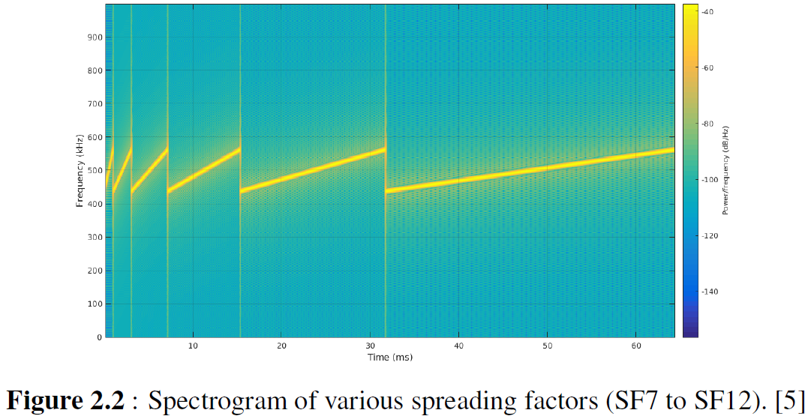
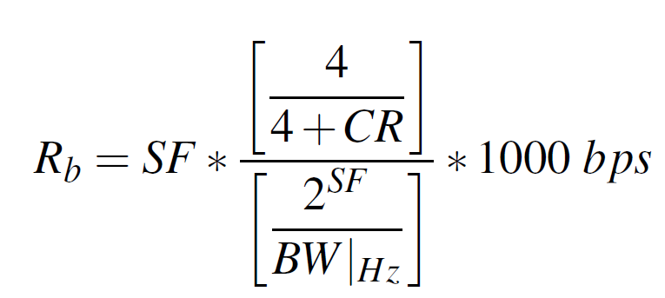
Introduction
LoRa & LoRaWAN
Related Works
Proposed Technique
Simulation Environment
Simulation Results
Conclusion
LoRa: Modulation
Higher SF:
Lower data rate
Longer transmission duration
Higher power consumption
Higher resilience to noise
Longer transmission range
Fig. A: Spectrogram of various spreading factors (SF7 to SF12). ^{[1]}
1. Image Source: https://www.sghoslya.com/p/lora-is-chirp-spread-spectrum.html
Notes:
LoRa modulates the signals in Sub-GHz ISM band using a proprietary modulation technique based on Chirp Spread Spectrum
It is resilient to interference and noise
Chirp is a sinusoidal signal which its frequency increases or decreases over time
And the speed of the scan is called the spreading factor
increasing spreading factor:
decreases data rate
increases transmission duration
increases power consumption
However it makes the signal more resilience to noise
Thus increases transmission range
Spreading factor determines data rate of a LoRa transmission
Here Rb is bit rate in bps, SF is spreading factor, CR is error correction code rate BW is bandwidth in Hertz
SF can take values between 7 and 12
CR can take values between 1 and 4
When bandwidth and code rate are constant as the spreading factor increases, the data rate decreases
Higher spreading factors delivers long range at an expense of lower data rate and high power consumption

Slide 7
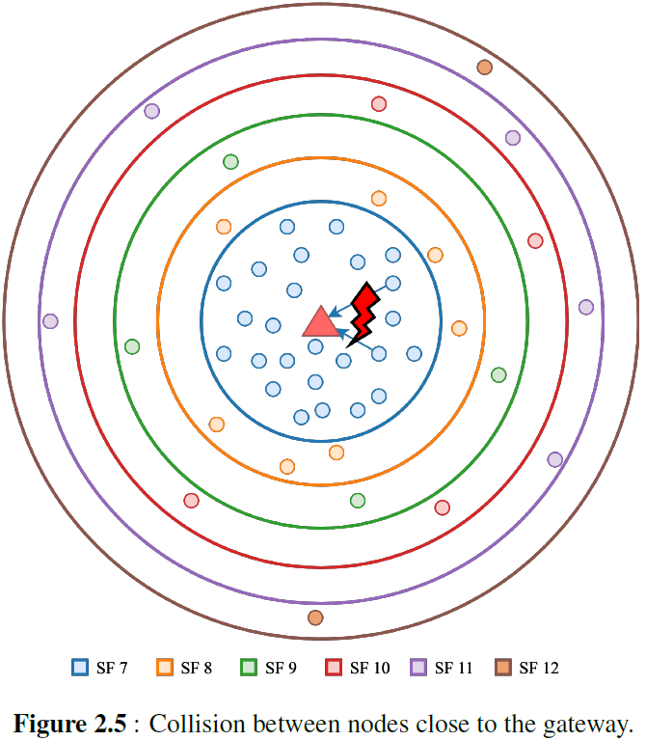
Introduction
LoRa & LoRaWAN
Related Works
Proposed Technique
Simulation Environment
Simulation Results
Conclusion
LoRa: Spreading Factor Assignment Issue
Different SF transmissions are orthogonal to each other
Packets with different SFs in same channel can be received simultaneously
Simultaneous transmissions with same SF may collide
End nodes select SF according to signal strength of the downlink transmission from GW
End nodes which close to the GW will probably select the lowest SF all the time
Same SF transmission collision
Number of collisions increases while number of end devices close to the GW increases
Fig. 1: Collision between nodes close to the gateway.
Notes:
Simultaneous different spreading factor transmissions are orthogonal to each other
Which means gateway can simultaneously receive multiple transmissions with different spreading factors
But simultaneous transmissions with the same spreading factor may not be received due to collision
initially, a node is not aware of how far away it is from a gateway. However, it can guess by observing received signal power of a downlink transmission
End nodes which close to the gateway will probably select the lowest spreading factor all the time which results
Same spreading factor transmission collisions
collisions increases while number of end devices close to the gateway increases

Slide 8
Introduction
LoRa & LoRaWAN
Related Works
Proposed Technique
Simulation Environment
Simulation Results
Conclusion
LoRaWAN
LoRaWAN is open standard MAC layer protocol for LoRa physical layer, developed by LoRa Alliance
End Node (EN)
Low power embedded device that only communicates with gateways
End nodes cannot communicate with each other
End nodes do not check whether the channel is free or not before transmission
Pure ALOHA medium access
Class A
Generates uplink transmission at any time
Only receives a period of time after an uplink transmission
Default operation mode
Suitable for battery powered applications
Notes:
LoRa has an open standard MAC layer protocol called LoRaWAN
There are three main LoRaWAN network entities, which are end node, gateway and network server
End node is a low power embedded device that only communicates with gateways
End nodes cannot communicate with each other
End nodes work in pure ALOHA manner
LoRaWAN standard defines three classes for end devices
Class A end nodes generate uplink transmission at any time
And Only receives a period of time after an uplink transmission
Class A is the default operation mode for end nodes
In this work, only Class A end devices are considered since Class A behavior leads to the lowest power consumption and Class A is the default operation mode.
Class B end nodes extend Class A behavior by adding scheduled periodic receive windows
Class C end nodes extend Class A behavior by keeping receive window open all the time

Slide 9
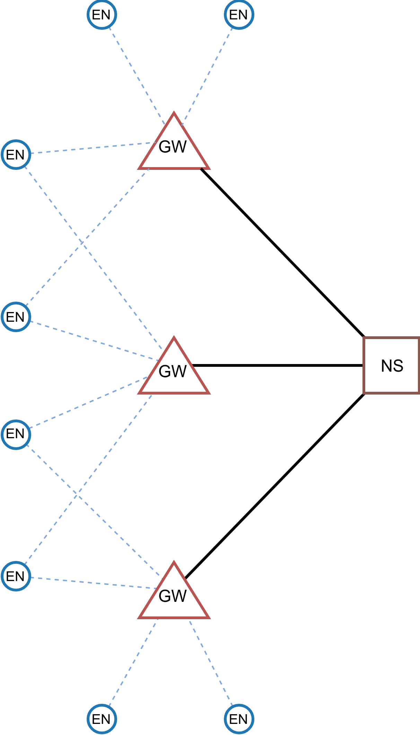
Introduction
LoRa & LoRaWAN
Related Works
Proposed Technique
Simulation Environment
Simulation Results
Conclusion
LoRaWAN
Gateway (GW)
Receive/transmit packets coming from/to end nodes
Messages transmitted by end nodes are received by all GWs in range
Network Server (NS)
Brain of the LoRaWAN network
Process hungry calculations and applications such as triangulation
Can tweak communication parameters of nodes such as SF and TX power
Adaptive Data Rate (ADR)
ADR algorithm implementation is left to network operators
Fig. B: LoRaWAN architecture.
Notes:
Next entity is gateway
gateway receives packets coming from end nodes
Messages transmitted by end nodes are received by all GWs in range
Network Server is the brain of the LoRaWAN network
Process hungry calculations and applications can be run in NS such as triangulation
Network server can tweak communication parameters of nodes such as spreading factor and transmit power
This is done by Adaptive Data Rate mechanism
If ADR is enabled, then spreading factor of the end node’s are controlled by the NS.
But The ADR algorithm is not defined in LoRaWAN protocol.
ADR algorithm implementation is left to the network operators.

Slide 10
Introduction
LoRa & LoRaWAN
Related Works
Proposed Technique
Simulation Environment
Simulation Results
Conclusion
Related Works
“Performance Evaluation of LoRa Networks in a Smart City Scenario” [5]
ns–3 module to study the performance of a LoRa-based IoT network in a typical urban scenario
SF assignment has great effect on LoRaWAN network performance
“Impact of LoRa Imperfect Orthogonality: Analysis of Link-Level Performance” and “Scalability Analysis of a LoRa Network under Imperfect Orthogonality” [7] and [8]
Effects of imperfect orthogonality between different LoRa spreading factor transmissions
Aggregated co-SF and inter-SF interference power SIR distributions to capture the coverage distance from the gateway for modeling interference
The adaptive data rate (ADR) algorithm recommended by Semtech utilizes SNR of the last 20 transmissions [9]
Selects the lowest possible SF and transmit power to maintain reliable communication between end node and gateway
Current state of the art implementation
Notes:
Related literature has started to grow recently
These are some of the notable related works on LoRa spreading factor assignment issue
In this [5]
Authors created a ns–3 module to study the performance of a LoRa-based IoT network in a typical urban scenario
They showed that spreading factor assignment has great effect on LoRaWAN network performance
In these tow paper [7] and [8]
Authors investigated Effects of imperfect orthogonality between different LoRa spreading factor transmissions
The adaptive data rate algorithm recommended by Semtech utilizes signal to noise ratio of the last 20 transmissions
Recommended algorithm selects the lowest possible spreading factor and transmit power to maintain reliable communication between end node and gateway
It can be said that this is the current state of the art implementation
The Things Network, one of the biggest LoRaWAN networks in the world, is utilizing this algorithm for their deployed networks

Slide 11
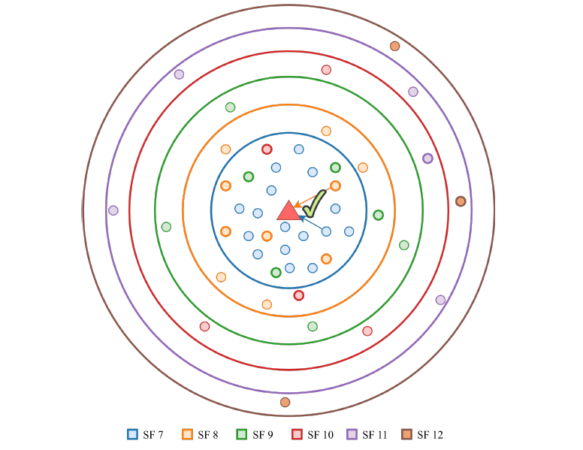
Introduction
LoRa & LoRaWAN
Related Works
Proposed Technique
Simulation Environment
Simulation Results
Conclusion
Proposed Technique: Solution
Network server can force some of close end nodes to select higher SF
Number of collision may decrease due to the orthogonality of different SF
However, higher SF:
Higher time on air
Prone to collision with other higher SF transmissions
Fig. 2: Collision avoidance by using higher SF for nodes close to the gateway.
Notes:
The collision problem I mentioned previously can be solved by forcing some of the close nodes to select higher spreading factors even they are able to communicate with lower spreading factors
Number of collision may decrease due to the orthogonality of different spreading factor
However, higher spreading factor means
Higher time on air
And this will increase the probability of collisions with other high spreading factor transmission

Slide 12
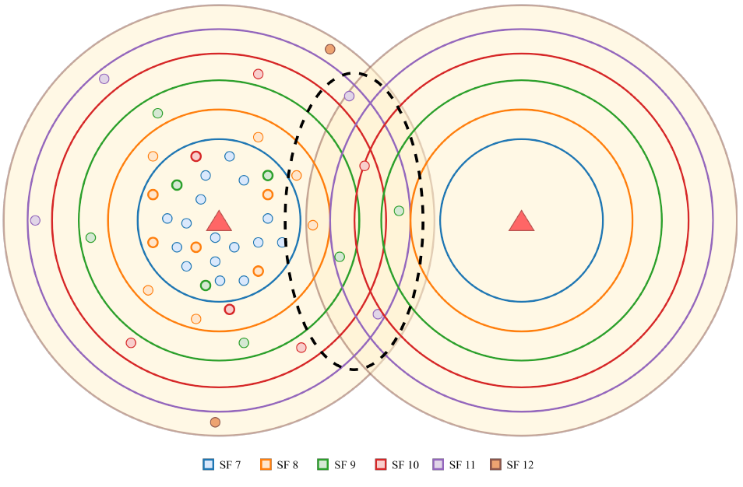
Introduction
LoRa & LoRaWAN
Related Works
Proposed Technique
Simulation Environment
Simulation Results
Conclusion
Proposed Technique: Challenge
Increasing SF may increase the collisions with nodes in other GW's range
Extra care must be taken for intersection area
How NS should assign SFs to nodes?
It is difficult to propose a single SF assignment rule for every possible topology
Every network is different
Optimizing nodes’ SFs requires different rules
Network aware machine learning based SF assignment approach is proposed
Fig. 3: Collision avoidance for intersecting gateways.
Notes:
In multiple gateways scenarios, this approach may increase the collisions with the nodes in other gateways’ range
So extra care should be taken for nodes in the intersection area
Distribution of spreading factor among nodes becomes an important problem
It is difficult to propose a single spreading factor assignment rule for every possible LoRaWAN topology since
every network is different
optimizing their nodes’ spreading factors requires different rules
For these reason a network aware machine learning based spreading factor assignment approach is proposed

Slide 13
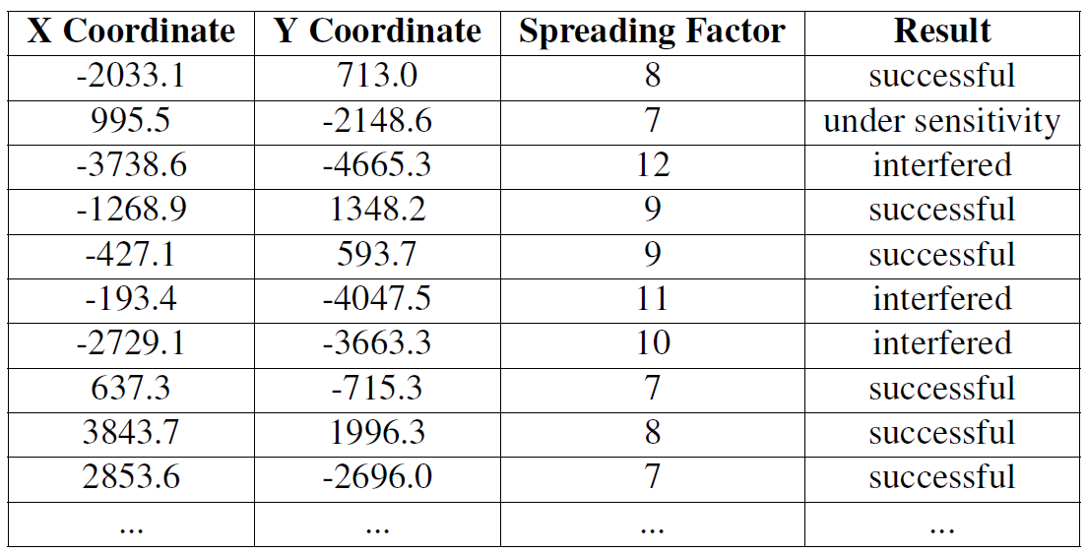
Introduction
LoRa & LoRaWAN
Related Works
Proposed Technique
Simulation Environment
Simulation Results
Conclusion
Proposed Technique
NS can keep track of transmission logs:
Location
X and Y coordinates (by triangulation)
SF
Transmission result
Successful
Interfered
Under sensitivity
Table A: Sample section of a transmission dataset.
Notes:
In this approach, NS can keep track of transmission logs with
Transmission location.
Spreading factor
And transmission results. Possible transmission results are
Successful
Interfered
And under sensitivity
You can see sample section of transmission logs

Slide 14
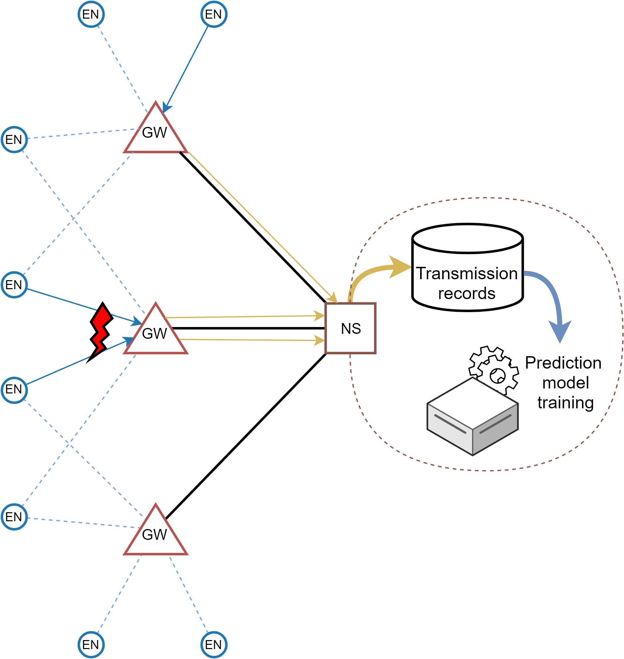
Introduction
LoRa & LoRaWAN
Related Works
Proposed Technique
Simulation Environment
Simulation Results
Conclusion
Proposed Technique
NS can train a classifier to predict future transmission result for a specific location and a specific SF
Decision tree classifier (DTC) and support vector machine (SVM) machine learning methods
Using this prediction model NS can calculate new SFs considering prediction of transmissions
If a transmission result is predicted as interfered
increase SF
predict a new transmission result
Notes:
Using those obtained information, NS can train a classifier to predict future transmission result for a specific node and a specific spreading factor
decision tree classifier and support vector machine methods are employed to predict the transmission results
Using this prediction model NS can assign spreading factors to nodes considering the collision probability.
If the transmission result is predicted as interfered, then the tool increases the spreading factor and predicts a new transmission result

Slide 15
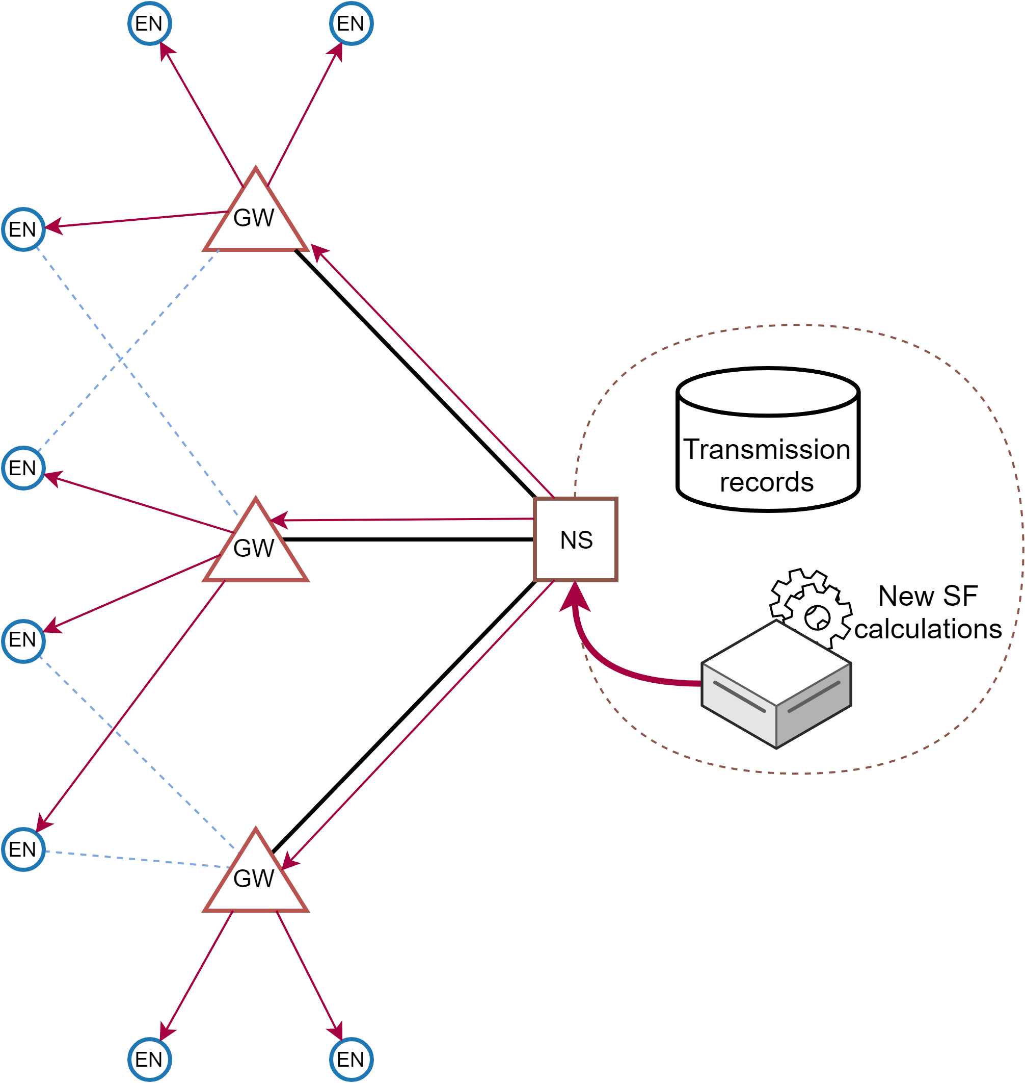
Introduction
LoRa & LoRaWAN
Related Works
Proposed Technique
Simulation Environment
Simulation Results
Conclusion
Proposed Technique
NS can modify SF of a node using existing ADR mechanism
No change required on LoRaWAN protocol
Every end node makes at least one uplink transmission in a day
At least one open receive window every day to inform end nodes about new spreading factor
Notes:
NS can modify spreading factor of the node using existing ADR mechanism.
Thus, this technique does not require any modification on LoRaWAN protocol.
It is fair enough to assume that every end node makes at least one uplink transmission in a day
so there is at least one open receive window every day to inform end nodes about new spreading factor.

Slide 16
Introduction
LoRa & LoRaWAN
Related Works
Proposed Technique
Simulation Environment
Simulation Results
Conclusion
Proposed Technique: Simulation
The tool first runs a simulation with random SF scheme
Transmission logs are combined to create the training dataset
The dataset is fed to DTC or SVM classifiers for training
Second simulation is run with the trained classifier
The tool selects new SF for transmissions considering transmission predictions
Notes:
The tool first runs a simulation with random spreading factor scheme.
After random spreading factor scheme simulation completed, transmission logs are combined into three feature columns one class label column
Then, the dataset is fed to DTC or SVM classifiers for training phase.
Then, Second simulation is run with the trained classifier.
The tool selects new spreading factor for transmissions considering transmission predictions

Slide 17
Introduction
LoRa & LoRaWAN
Related Works
Proposed Technique
Simulation Environment
Simulation Results
Conclusion
Simulation Environment
Discrete event simulation tool is developed to study the effects of various SF strategies for LoRaWANs
Python
From scratch
Open source
Capabilities
LoRaWAN Class A only
Uplink transmission only
Notes:
For this work a discrete event simulator is developed from scratch in Python to study the effects of various spreading factor strategies
The tool source code is open source and available at GitHub
Simulator only supports LoRaWAN Class A end devices
Since Class A behaviour is the default operation mode and provides the lowest power consumption.
Downlink transmissions are not considered. Since they are rare in real world deployments because of ISM band regulations dictate duty cycle transmission limit for all devices including gateways
The tool is designed to simulate smart spreading factor schemes, thus machine learning libraries are integrated to the tool. Integrating smart spreading factor schemes to the existing LoRa/LoRaWAN simulation tools such as ns-3 would require major changes. Thus, the tool is designed and developed from scratch to make it easier to integrate smart spreading factor schemes.

Slide 18
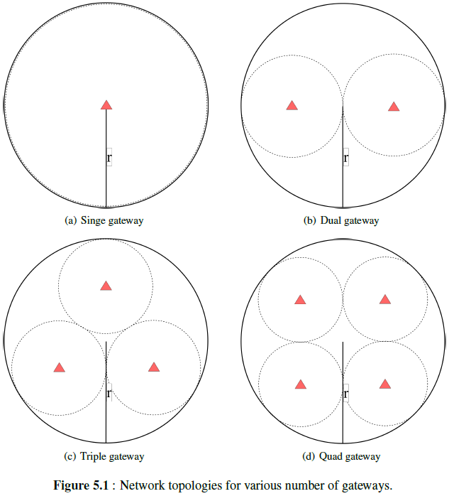
Introduction
LoRa & LoRaWAN
Related Works
Proposed Technique
Simulation Environment
Simulation Results
Conclusion
Simulation Environment: Inputs
Simulation topology inputs:
radius (m)
number of nodes
number of gateways
Fig. C: Network topologies for various number of gateways.
Notes:
Simulator can generate uniformly distributed circular shape network topology with input parameters:
radius in meter,
number of nodes
and number of gateways.
The tool first distributes gateways
Then, randomly places end nodes in network radius.

Slide 19
Introduction
LoRa & LoRaWAN
Related Works
Proposed Technique
Simulation Environment
Simulation Results
Conclusion
Simulation Environment: Inputs
Simulation inputs:
simulation duration (s)
packet size (B)
packet generation rate (pps)
SF assignment method
Notes:
Global simulation input parameters are
simulation duration in second
packet size in Byte
packet generation rate in packets per second
spreading factor assignment method

Slide 20
Introduction
LoRa & LoRaWAN
Related Works
Proposed Technique
Simulation Environment
Simulation Results
Conclusion
Simulation Environment: Outputs
Simulation outputs:
number of generated packets
number of successfully received packets
number of interfered packets
number of under sensitivity packets
network packet delivery ratio percentage
total transmit energy consumption (J)
Notes:
With these inputs the simulator produces
number of generated packets
number of successfully received packets
number of interfered packets
number of under sensitivity packets
Network packet delivery ratio percentage,
network throughput in bits per second
and total transmit energy consumption in Joule
Simulator also produces prediction accuracy percentage and confusion matrix for machine learning schemes.

Slide 21

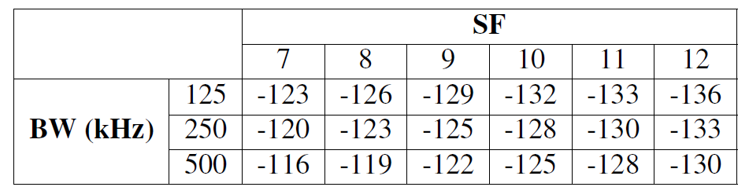
Introduction
LoRa & LoRaWAN
Related Works
Proposed Technique
Simulation Environment
Simulation Results
Conclusion
Simulation Environment: Link Model
Link quality of a wireless system:
Sum of system gains and system losses is assumed as +7 dB
All transmissions use maximum allowed transmit power 14 dBm
Table I: Gateway sensitivity for different SFs [13].
Notes:
Link quality of a wireless system can be expressed by the link budget
Link budget can be calculated by this formula where
PRX is the expected receive power at the receiver
PTX is the transmit power of the transmitter
G SYS is the system gains such as transmitter and receiver antenna gains
L SYS is the system losses such as transmitter and receiver line, circuit, antenna losses
L PATH is the propagation path loss between transmitter and receiver antennas in open space
it is assumed that sum of system gains and system losses is +7 dB
it is assumed that nodes always select maximum allowed transmit power, which is 14 dBm.
If the received signal power is higher than the gateway sensitivity,
then signal can be decoded by the receiver successfully when there is no interfering transmission.

Slide 22

Introduction
LoRa & LoRaWAN
Related Works
Proposed Technique
Simulation Environment
Simulation Results
Conclusion
Simulation Environment: Link Model
Free space propagation loss:
Assume h = 15 m and f = 868 MHz
Notes:
Free space propagation loss is calculated as
Where h is the gateway altitude and f is the frequency of the signal,
It is assumed that gateway altitude is 15 m and frequency is 868 MHz which is European ISM band frequency
With these assumptions, propagation loss calculation become

Slide 23
Introduction
LoRa & LoRaWAN
Related Works
Proposed Technique
Simulation Environment
Simulation Results
Conclusion
Simulation Environment: Interference Model
It is assumed that there is no other technology interference
Simulator calculates the effect of different SF transmissions to each other
Signal to interference plus noise ratio threshold matrix
If there are more than one interfering signal
Cumulative sum of all interfering signal received power for each SF
Notes:
In this work, it is assumed that there is no other technology interference in the network except LoRa interference
Simulator calculates the effect of different spreading factor transmissions to each other
Signal to interference plus noise ratio threshold matrix is adopted from previous works
If there are more than one interfering signal, referenced signal must satisfy the margin for sum of all interfering signal received power for each spreading factor

Slide 24
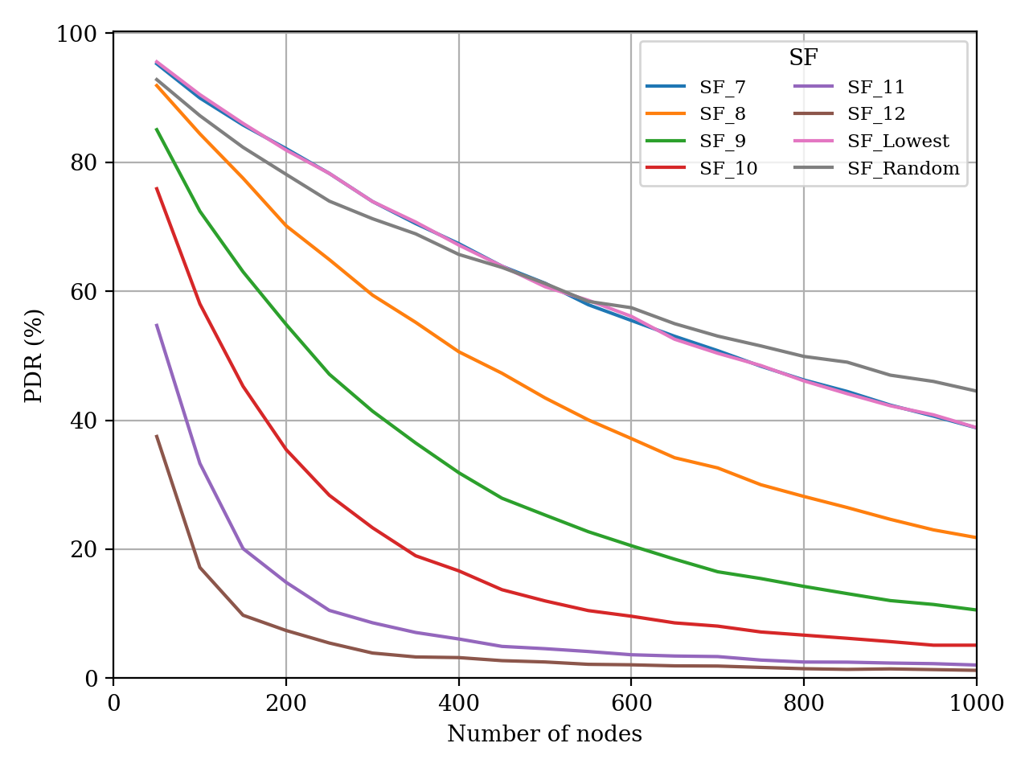
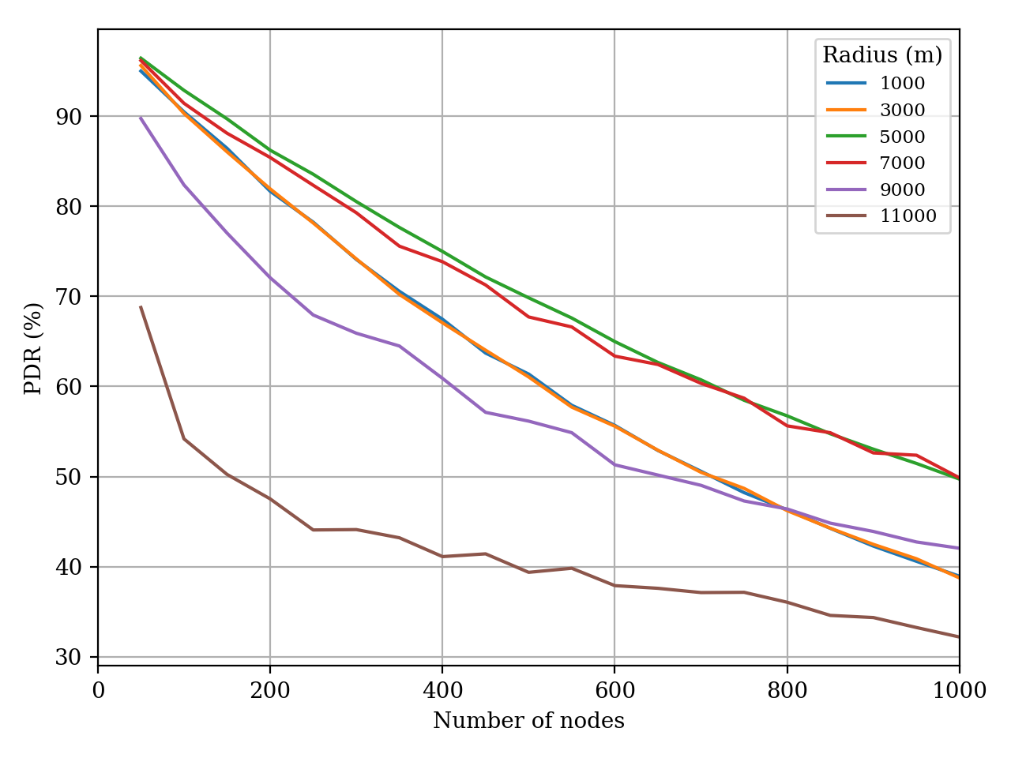
Introduction
LoRa & LoRaWAN
Related Works
Proposed Technique
Simulation Environment
Simulation Results
Conclusion
Simulation Results: Single Gateway
Fig. 4 : PDR plot for various spreading factors. (r = 3000 m, GW = 1)
Fig. 5 : PDR plot for various network radii. (GW = 1, SF = SF_Lowest)
Notes:
First, I will present single gateway and multiple gateway simulation results to show correctness of the simulator
These figures validate the tool we get the expected results
Here PDR plot of various spreading factor assignment schemes is shown
Increasing spreading factors, increases time on air
This increases the number of collisions thus decreases the PDR
High spreading factors gives poor PDR results as the number of nodes increases
plot for various network radii is shown
lowest spreading factor assignment scheme is used for these plots
Increasing network radius,
increases the number of under sensitivity transmissions
thus decreases the PDR
Nodes select higher spreading factors when they are far away from the gateway.
Thus, higher spreading factor leads to
longer air time,
higher number of collisions
and higher total transmit power consumption

Slide 25
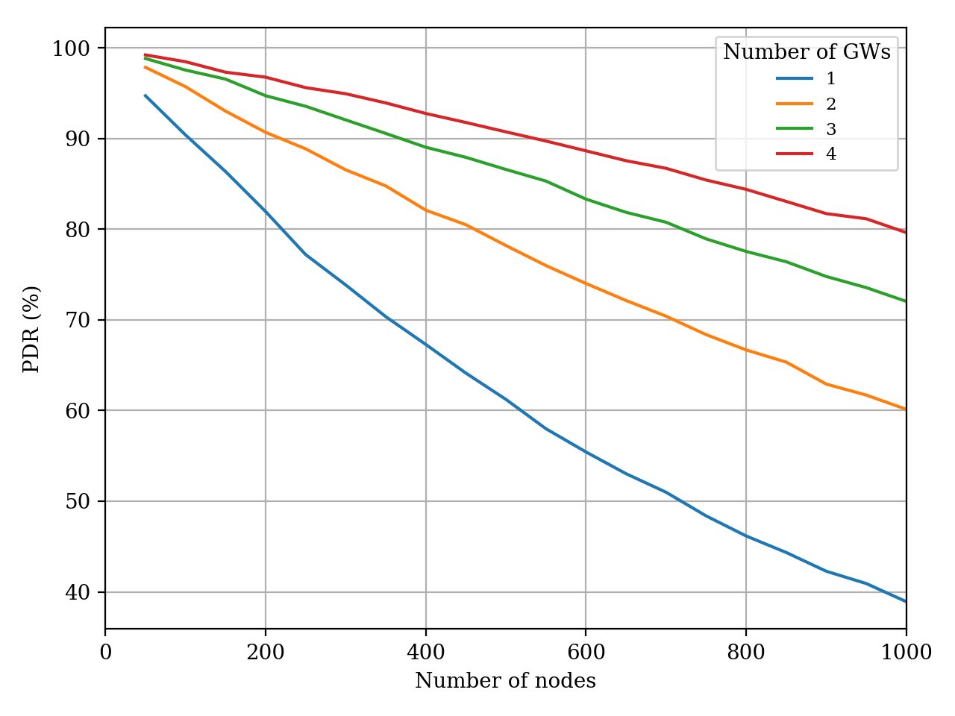
Introduction
LoRa & LoRaWAN
Related Works
Proposed Technique
Simulation Environment
Simulation Results
Conclusion
Simulation Results: Multiple Gateway
Fig. 6 : PDR plot for various number of gateways. (r = 3000 m, SF = SF_Lowest)
Notes:
plots for various number of gateways are shown
Increasing number of gateways in constant topology radius,
decreases the distance between nodes and gateways
Thus, decreases the number of collisions at gateways
Hence, increases the PDR.
Since topology radius is small, most of the end nodes selects lowest spreading factor all the time
Thus air time is same and total transmit power consumption is same for all plots

Slide 26
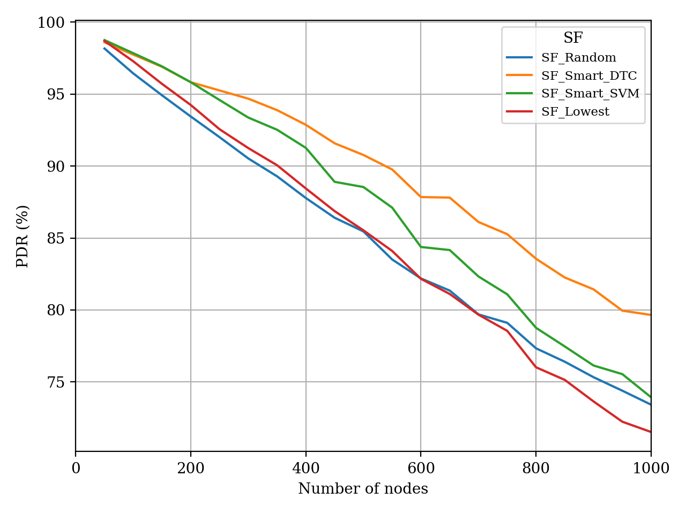
Introduction
LoRa & LoRaWAN
Related Works
Proposed Technique
Simulation Environment
Simulation Results
Conclusion
Simulation Results: Smart SF Schemes
Fig. 7: PDR plot for lowest and smart spreading factor schemes. (r = 5000 m, GW = 3)
Notes:
Finally plot for the smart spreading factor scheme is shown, this plot is main objective and main results of this work
Both smart SVM and smart DTC schemes give better PDR than lowest spreading factor schemes when number of nodes increases.
Increasing number of nodes, increases number of interferences.
Smart schemes can only improve network performance when LoRa interference is high.
Moreover, smart schemes give better results when nodes are deployed closer to the gateway, since nodes have margin to increase their spreading factors when they are deployed closer to the gateway
If a node is far away from gateway, then smart schemes cannot increase the spreading factor to avoid interference since the assigned spreading factor is already high.
As number of nodes increases, both smart SVM and smart DTC schemes give better PDR results

Slide 27
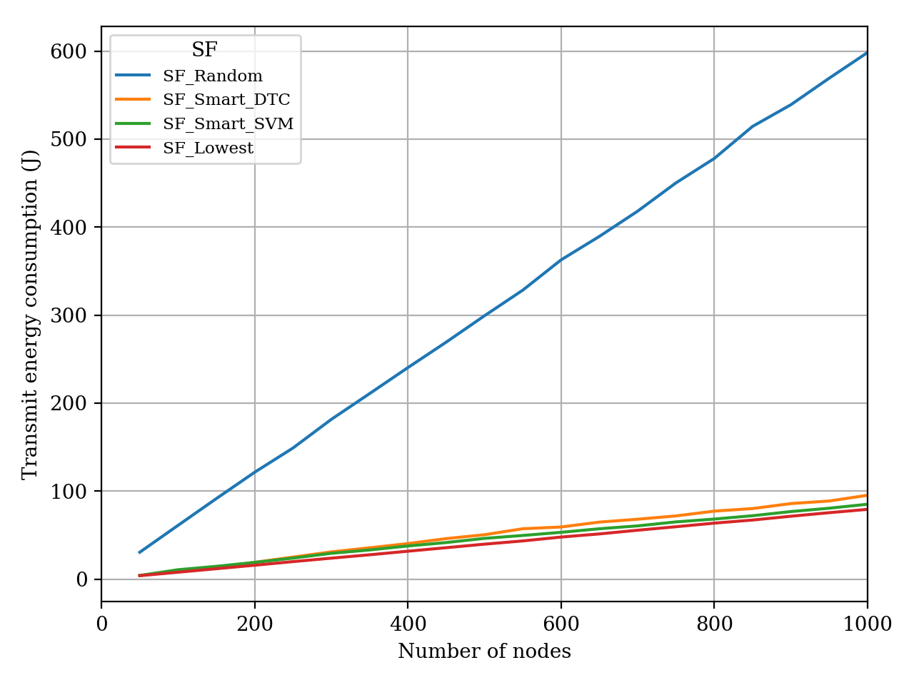
Introduction
LoRa & LoRaWAN
Related Works
Proposed Technique
Simulation Environment
Simulation Results
Conclusion
Simulation Results: Smart SF Schemes
Fig. 8: Transmit energy plot for lowest and smart spreading factor schemes. (r = 5000 m, GW = 3)
Notes:
As number of nodes increases, both smart SVM and smart DTC schemes consume slightly more energy than lowest spreading factor scheme,
however they give better PDR results in return
Random spreading factor scheme consumes much higher transmit power than the rest.

Slide 28
Introduction
LoRa & LoRaWAN
Related Works
Proposed Technique
Simulation Environment
Simulation Results
Conclusion
Conclusion
SF assignment on network performance is investigated in detail
Factors that increase the number of collisions are evaluated
Measures that can be taken to reduce collisions are described
A discrete event simulator is developed from scratch to study SF assignment strategies
A novel method which utilizes machine learning techniques is proposed
Simulation results show smart SF methods provide promising network performance improvements especially for dense LoRaWAN networks
Notes:
To summarize, in this work
Spreading factor assignment on network performance is investigated in detail
Factors that increase the number of collisions are evaluated
Measures that can be taken to reduce collisions are described
A discrete event simulator is developed from scratch to study Spreading factor assignment strategies
A novel method which utilizes machine learning techniques is proposed
Simulation results show smart Spreading factor methods provide promising network performance improvements especially for dense LoRaWAN networks

Slide 29
Introduction
LoRa & LoRaWAN
Related Works
Proposed Technique
Simulation Environment
Simulation Results
Conclusion
Conclusion
As for future work
Transmit power optimization
Class B and Class C end node behavior
Other machine learning methods such as reinforcement learning
Other transmission parameters such as node id and transmission time can be included
Notes:
As for future work,
transmit power optimization can be included to the proposed smart schemes
In this thesis, it is assumed that nodes always use maximum transmit power for uplink transmission, however nodes close to gateways can decrease transmit power to save energy
it is also assumed that only LoRaWAN Class A end nodes are present, however Class B and Class C end node behavior can be integrated to check how extra downlink communication effects smart SF schemes
Moreover, other machine learning methods can be investigated. Reinforcement learning could be a good candidate.
Also, other transmission parameters such as node id and transmission time can be included to the proposed scheme in order to improve prediction performance

Slide 30
Notes:
Thank you for your attention.

Slide 31
References
M. Centenaro, L. Vangelista, A. Zanella, and M. Zorzi, “Long-range communications in unlicensed bands: the rising stars in the IoT and smart city scenarios,” IEEE Wireless Communications, vol. 23, no. 5, pp. 60–67, October 2016.
U. Raza, P. Kulkarni, and M. Sooriyabandara, “Low Power Wide Area Networks: An Overview,” IEEE Communications Surveys Tutorials, vol. 19, no. 2, pp. 855–873, January 2017.
O. Georgiou and U. Raza, “Low Power Wide Area Network Analysis: Can LoRa Scale?” IEEE Wireless Communications Letters, vol. 6, no. 2, pp. 162–165, April 2017.
“LoRa Modulation Basics,” Semtech Corporation, Camarillo, California, USA, Tech. Rep. AN1200.22, May 2015. [Online]. Available: https://www.semtech.com/uploads/documents/an1200.22.pdf
D. Magrin, M. Centenaro, and L. Vangelista, “Performance evaluation of LoRa networks in a smart city scenario,” in 2017 IEEE International Conference on Communications (ICC), May 2017, pp. 1–7.
F. Van den Abeele, J. Haxhibeqiri, I. Moerman, and J. Hoebeke, “Scalability Analysis of Large-Scale LoRaWAN Networks in ns-3,” IEEE Internet of Things Journal, vol. 4, no. 6, pp. 2186–2198, December 2017.
D. Croce, M. Gucciardo, S. Mangione, G. Santaromita, and I. Tinnirello, “Impact of LoRa Imperfect Orthogonality: Analysis of Link-Level Performance,” IEEE Communications Letters, vol. 22, no. 4, pp. 796–799, April 2018.
A. Mahmood, E. Sisinni, L. Guntupalli, R. Rond´on, S. A. Hassan, and M. Gidlund, “Scalability Analysis of a LoRa Network under Imperfect Orthogonality,” IEEE Transactions on Industrial Informatics, pp. 1–1, September 2018.
“LoRaWAN simple rate adaptation recommended algorithm,” Semtech Corporation, Camarillo, California, USA, Tech. Rep. v1.0, October 2016.
E. Alpaydin, Introduction to Machine Learning, 2nd ed. The MIT Press, 2010.
T. Yatagan, “tugrulyatagan/simlorasf,” May 2019. [Online]. Available: https://doi.org/10.5281/zenodo.2671495
“LoRaWAN 1.1 Regional Parameters,” LoRa Alliance, San Ramon, California, USA, Tech. Rep. v1.1rB, January 2018. [Online]. Available: https://lora-alliance.org/sites/default/files/2018-04/lorawantm regional parameters v1.1rb - final.pdf
“SX1276/77/78/79 - 137 MHz to 1020 MHz Low Power Long Range Transceiver Datasheet,” Semtech Corporation, Camarillo, California, USA, Tech. Rep., August 2016. [Online]. Available: https://www.semtech.com/uploads/documents/DS SX1276-7-8-9 W APP V5.pdf
“Radio Frequency (RF) system scenarios,” ETSI, Tech. Rep. TR 136 942 V13.0.0, January 2016. [Online]. Available: https://www.etsi.org/deliver/etsi tr/136900136999/136942/13.00.00_60/tr 136942v130000p.pdf
C. Goursaud and J. M. Gorce, “Dedicated networks for IoT : PHY / MAC state of the art and challenges,” EAI endorsed transactions on Internet of Things, October 2015. [Online]. Available: https://hal.archives-ouvertes.fr/hal-01231221

Slide 32
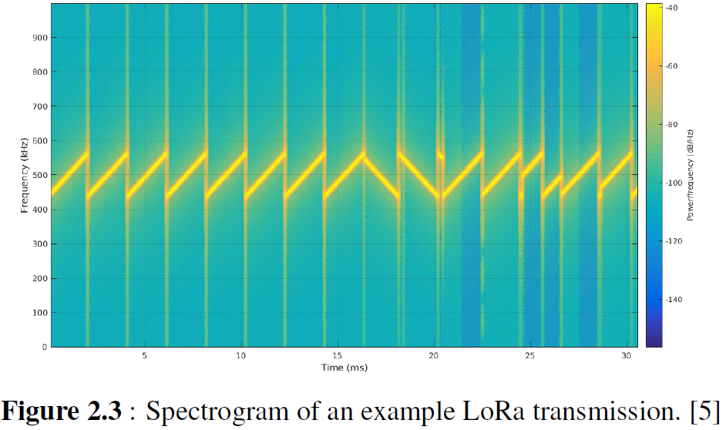
Appendix
LoRa: Spreading Factor
Ratio between symbol and chirp rate is equal to 2^{SF}
SF can take values between 7 and 12
SF provides tradeoff between data rate, range and power consumption
Fig. C: Spectrogram of various spreading factors (SF7 to SF 12). ^{[1]}
Fig. D: Spectrogram of an example LoRa transmission. ^{[1]}
1. Image Source: https://www.sghoslya.com/p/lora-is-chirp-spread-spectrum.html
Notes:
The ratio between symbol and chirp rate is equal to 2^{SF}
Spreading factor also determines data rate of a LoRa transmission
Here Rb is bit rate in bps, SF is spreading factor, CR is error correction code rate BW is bandwidth in Hertz
SF can take values between 7 and 12
CR can take values between 1 and 4
When bandwidth and code rate are constant as the spreading factor increases, the data rate decreases
Higher spreading factors delivers long range at an expense of lower data rate and high power consumption

Slide 33
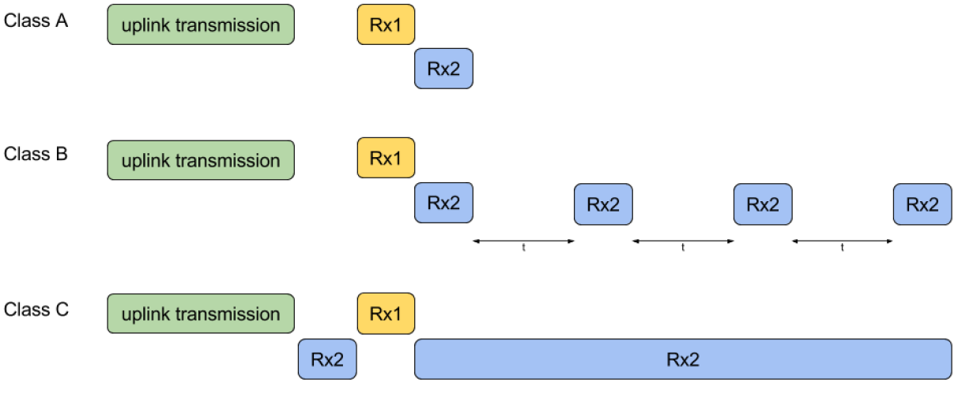
Appendix
LoRaWAN
End Node (EN)
Low power embedded device that only communicates with gateways
Class A
Generates uplink transmission at any time
Only receives a period of time after an uplink transmission
Default operation mode
Suitable for battery powered applications
Class B
Periodic receive window
Suitable for low latency applications
Class C
Continuous receive window
Suitable for no latency applications
Fig. E: LoRaWAN class A, B and C TX/RX timing diagram. ^{[1]}
1. Image Source: https://witekio.com/blog/lorawan-dedicated-iot-network
Notes:
LoRa has an open standard MAC layer protocol called LoRaWAN
LoRaWAN is developed and maintained by LoRa Alliance which is an non-profit organization
There are three main LoRaWAN network entities, which are end node, gateway and network server
End node is a low power embedded device that only communicates with gateways
LoRaWAN standard defines three classes for end devices
Class A end nodes generate uplink transmission at any time
And Only receives a period of time after an uplink transmission
Class A is the default operation mode for end nodes
Class B end nodes extend Class A behavior by adding scheduled periodic receive windows
Class C end nodes extend Class A behavior by keeping receive window open all the time
In this thesis, only Class A end devices are considered since Class A behavior leads to the lowest power consumption and Class A is the default operation mode.

Slide 34
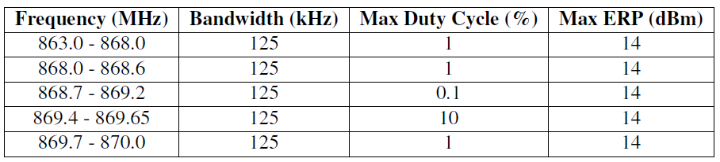
Appendix
LoRa: ISM Regulations
LoRaWAN operates in license free Industrial, Scientific, and Medical (ISM) bands
ISM bands are subject to radio transmission time and power regulations
Duty cycle restriction
Limitation on percentage of air time
1% duty cycle restriction enforces
Single transmission cannot exceed 3.6 seconds
Total time on air in one hour cannot exceed 36 seconds
Effective isotropic radiated power restriction
Sets maximum allowed transmit power of a transmitter
Table B: EU863-870 ISM band LoRa channels.
Notes:
LoRaWAN operates in license free ISM bands.
ISM bands are subject to radio transmission time and power regulations
Duty Cycle Restriction is a limitation on percentage of air time.
For example 1% duty cycle restriction enforces
Single transmission cannot exceed 3.6 seconds
And total time on air in one hour cannot exceed 36 seconds
Effective Isotropic Radiated Power Restriction sets the maximum allowed transmit power of a transmitter

Slide 35
Appendix
Proposed Technique: Simulation
For every transmission:
The classifier predicts the transmission result for the lowest possible SF
If the transmission result is predicted as interfered
increase SF
predict a new transmission result
If new transmission result is classified as successful
continue to execute with selected SF
If no SF transmission result is predicted as successful
select the lowest possible SF
continue to execute
Notes:
For every transmission
the classifier predicts the transmission result for the lowest possible SF
If the transmission result is predicted as interfered, then the tool increases the spreading factor and predicts a new transmission result
If the new transmission result is classified as successful, then simulator continues to execute with selected spreading factor
If no spreading factor transmission result is predicted as successful, then the tool selects the lowest possible spreading factor again and continue to execute.

Slide 36
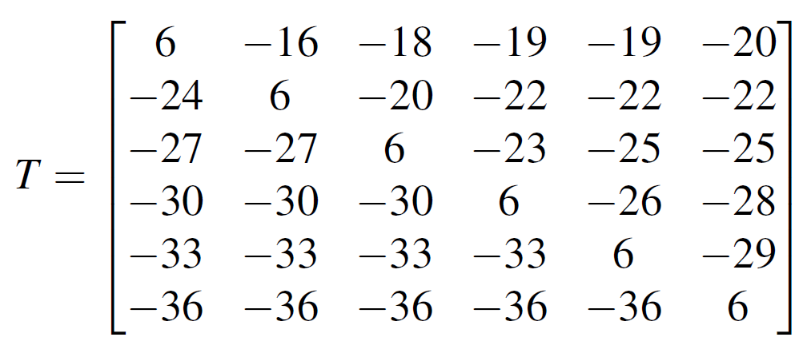
Appendix
Simulation Environment: Interference Model
It is assumed that there is no other technology interference
Simulator calculates the effect of different SF transmissions to each other
Signal to interference plus noise ratio threshold matrix [33]:
Margin between referenced signal and interfering signal to correctly decode the referenced signal
Notes:
In this work, it is assumed that there is no other technology interference in the network except LoRa interference
Simulator calculates the effect of different spreading factor transmissions to each other
signal to interference plus noise ratio threshold matrix is adopted
Where T ij is margin between referenced signal with SF = i and interfering signal with SF = j to correctly decode the referenced signal

Slide 37
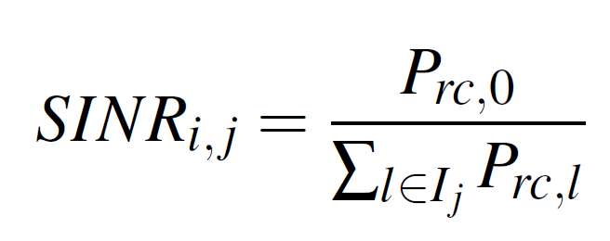
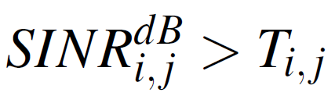
Appendix
Simulation Environment: Interference Model
If there are more than one interfering signal
Cumulative sum of all interfering signal received power for each SF
SINR threshold can be calculated
Packet survives from all interferences if:
Notes:
If there are more than one interfering signal, referenced signal must satisfy the margin for sum of all interfering signal received power for each spreading factor
SINR threshold can be calculated by this equation
Where Prc,0 is received signal power of referenced signal
Prc,l is received signal power of interfering signal for SF = j.
If a packet with SF = i satisfies the following condition for every SF = j, then packet is survived from all interferences.

Slide 38
Appendix
Simulation Environment: Software
Tool keeps an event queue
Every event is a transmission
Every transmission has
Time
SF
Source
Duration
Status
Simulation steps:
Every node generates an event according to their traffic generation rate
Initially all events are in pending state
Tool executes events
Tool marks events statuses as transmitted, interfered or under sensitivity
Tool calculates network PDR, throughput and transmit energy consumption
Example CLI command:
python3 main.py -r 7000 -g 3 -n 300 -s SF_Lowest -d 3600
Notes:
The tool keeps a transmission queue
Every event in this queue is a transmission
Every transmission has
time
spreading factor
source
Duration
and status fields
First
Every end node generates an event according to their traffic generation rate and inserts this event to event queue.
Initially all events are in pending state
Tool executes events one by one
Tool marks events statuses as transmitted, interfered or under sensitivity
Finally tool calculates network PDR, throughput and transmit energy consumption
A command line parser is developed for interacting with the tool, so the tool can be run without any programming or scripting
Example tool command is below

Slide 39
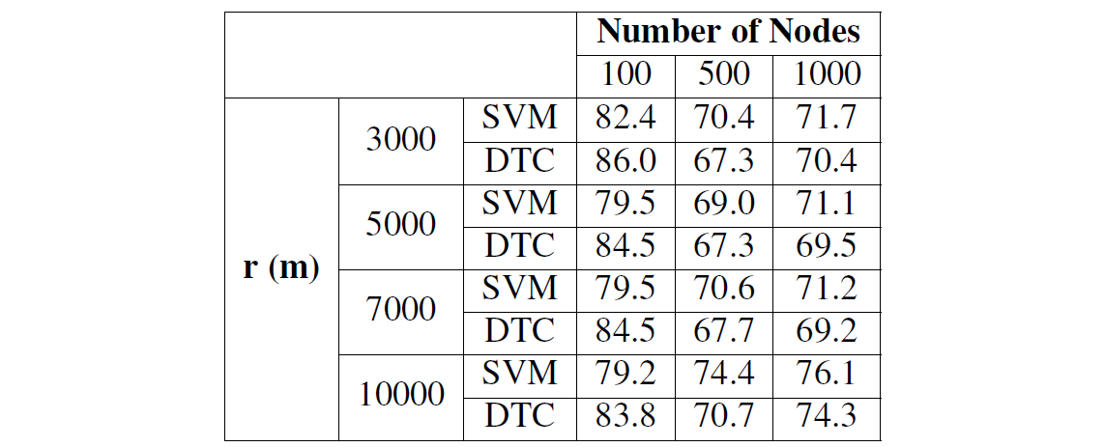
Introduction
LoRa & LoRaWAN
Related Works
Proposed Technique
Simulation Environment
Simulation Results
Conclusion
Simulation Results
Prediction accuracy is not directly proportional to network PDR
Correct prediction of an interfered transmission may not increase the PDR but increases the prediction accuracy
Table III: Prediction accuracy for SVM and DTC. (GW = 3)
Notes:
prediction accuracy of smart SVM and smart DTC schemes are presented for various network radii and number of nodes.
Prediction accuracy is not directly proportional to network PDR
Correct prediction of an interfered transmission may not increase the PDR but increases the prediction accuracy
Smart DTC gives better network PDR results than smart SVM, even overall smart SVM prediction accuracy is higher
The distribution of different labeled data points in the dataset is strongly related to simulation parameters.
If simulation is run with small topology radius and high number of nodes, then number of interfered transmission labeled data points increases.
On the other hand, using a large topology radius in the simulation causes the number of under sensitivity transmission labeled data points to increase.
Moderately dense network parameters are chosen to make it closer to real world deployments.
With the simulation parameters utilized in this section, simulation tool usually produces imbalanced dataset.
Number of under sensitivity transmission labeled data points are less than number of successful transmission labeled data points.
Besides, number of interfered transmission labeled data points are even less than number of under sensitivity transmission labeled data points. In this case, smart DTC predicts interfered transmission labeled data points more accurately.
Correct classification of interfered transmissions yields better network PDR results, thus smart DTC scheme gives better network PDR results.

